Slide 1
STEGANOGRAPHY
Presented By:
1. Student Name : Ambati Padmasri
2. College Name : Kakinada Institute of Engineering and Technology
3. Department : Artificial Intelligence and Data Science

Slide 2
Problem Statement
Design and implementation of Steganography
How can we send a message secretly to the destination?
Using Stenography, information can be hidden in carriers such as images, text files, audio files, videos and data transmission.
In this study, we proposed a new framework of an image steganography system to hide a digital text of a secret message.

Slide 3
AGENDA
Project overview.
Who are the end users of this project?
Your solution and its value proposition.
How did you customize the project and make it your own.
Modelling.
Results.
Links.

Slide 4
PROJECT OVERVIEW
Embedding the Secret Message:
Least Significant Bit (LSB) Method
Transform Domain Techniques
Masking and Filtering
Ensuring Detection Resistance:
Preserving Image Quality, Extracting the Hidden Message
Tools and Technologies:
Programming Languages
Libraries and Frameworks, Steganography Software
Evaluation and Testing:
Performance Metrics
Testing Scenarios

Slide 5
WHO ARE THE END USERS OF THIS PROJECT?
Government and Military Agencies.
Law Enforcement and Intelligence Agencies.
Corporate Enterprises.
Journalists and Whistleblowers.
Individuals Concerned with Privacy.
Researchers and Developers.
Security Consultants and Penetration Testers.

Slide 6
YOUR SOLUTION AND ITS VALUE PROPOSITION
Advanced Embedding Techniques:
Utilize sophisticated algorithms like Least Significant Bit (LSB) modification, transform domain techniques (DCT, DWT), and adaptive steganography to hide information within images with minimal impact on visual quality.
Enhanced Security Measures:
Implement encryption and cryptographic hash functions to protect the hidden data and ensure its integrity and confidentiality.
Robustness Against Detection:
Apply statistical and machine learning techniques to enhance the resistance of the steganographic system against steganalysis and detection attacks.
Automated Extraction Process:
Develop reliable and efficient algorithms to extract hidden information accurately, ensuring the integrity and confidentiality of the embedded data.

Slide 7
HOW DID YOU CUSTOMIZE THE PROJECT
The project was customized by integrating advanced cybersecurity measures, optimizing performance, and ensuring user-friendliness. This comprehensive approach not only meets the diverse needs of end users but also provides a robust and secure solution for embedding and extracting hidden information within digital images. The result is a versatile, reliable, and highly secure steganographic tool tailored to the specific requirements of various stakeholders.

Slide 8
MODELLING
Statistical Analysis:
Detection Resistance: Use statistical models to evaluate the resistance of the stego image (S) against steganalysis tools.
Noise and Distortion Handling:
Robustness Model: Ensure that the stego image maintains the hidden message integrity even when subjected to common distortions like compression, resizing, or noise.
Extraction Algorithm:
Extraction Function (g): Define a function g(S)g(S)g(S) to extract the hidden message from the stego image: M′=g(S)M' = g(S)M′=g(S).

Slide 9
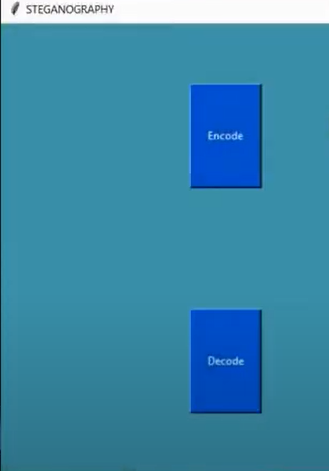
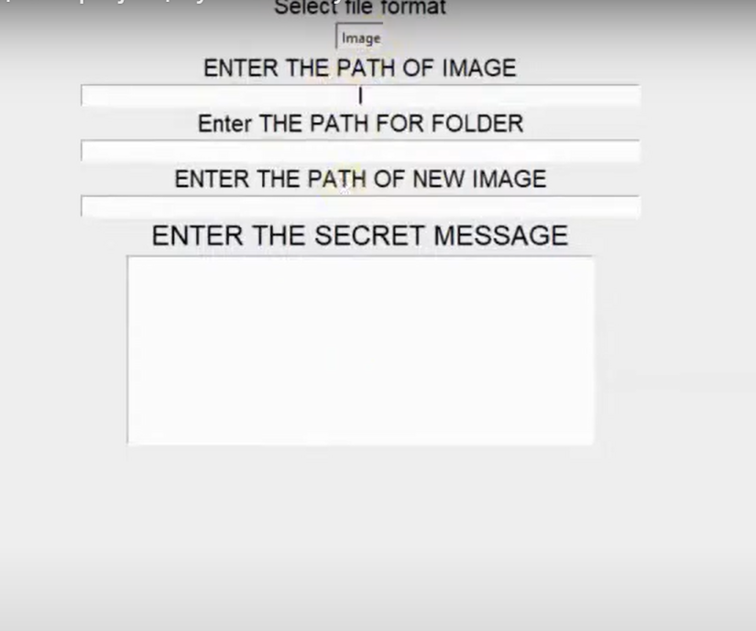
RESULTS

Slide 10
REFERENCE
List and cite relevant sources, research papers, and articles that were instrumental in developing the proposed solution. This could include academic papers on Image steganography, Cybersecurity and best practices.
https://github.com/PADMASRIAMBATI/Steganography_project.git

Slide 11
Thank You

